Slide 1
Basic Electronics
Logic Gates

Slide 2
Digital Electronics
Basic Digital circuits(AND, OR, NOT, NAND, NOR, EX-OR), Boolean Algebra, Examples of IC gates, Standard representation of IC gates
Half Adder, Full adder

Slide 3
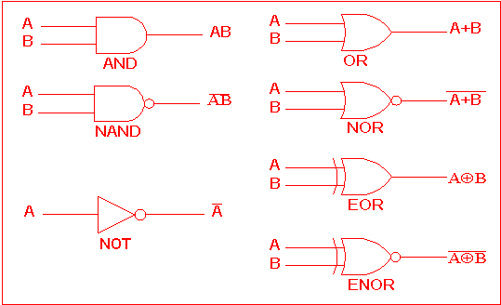
Logic Gates

Slide 4
Universal Gates
The NAND and NOR gates are known as universal gates, because any logic function can be implemented using NAND or NOR gates

Slide 5
Analyze Yourself
The logical inversion or complement is presented by the______ operator.
NOT
NAND
NOR
AND
The logical addition is presented by the _____ operator.
AND
OR
NAND

Slide 6
Analyze Yourself
3. The logical _____ is presented by the “AND” operator.
Multiplication
Addition
Subtraction
4. The output of OR gate is zero when ________.
Any one input is logic 1
Two inputs are logic 1
All inputs are logic 0

Slide 7
Analyze Yourself
5. The 14-pin TTL integrated cuircuit with four, two inputs ______ gates inside, is IC 7432.
OR
AND
NAND
6. The 14-pin TTL integrated circuit with four, two inputs ______ gates inside, is IC 7400.
OR
AND
NAND

Slide 8
Analyze Yourself
7. The output of a ______ gate is 1 only when all of its inputs are 1.
NOR
EX-OR
AND
NOT
8. A NAND gate is equivalent to an AND gate plus a ____ gate put together.
NOR
NOT
EX-OR

Slide 9
Analyze Yourself
9. Logic states can be only be ______ or 0.
3
2
1
0
10. A 14 pin NOT gate IC has ______ NOT gates.
8
6
5
4

Slide 10
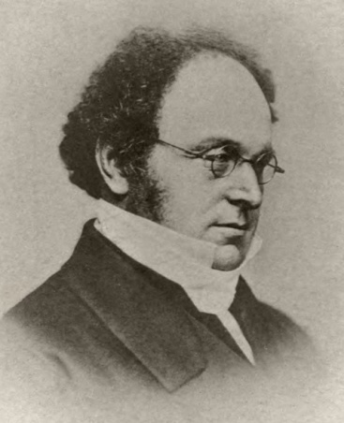
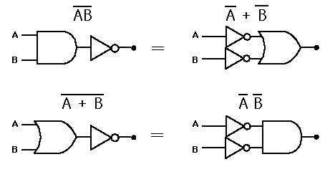
DeMorgan’s Theorem
1. The Complement of a Product is equal to the Sum of the Complements.
2. The Complement of a Sum is equal to the Product of the Complements.

Slide 11
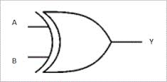
Ex-OR can be used as Inverter
If we tie one input of an XOR Gate with Logic value ’1′ then XOR works as an Inverter
Here if we give input as
A=1 and B=X
Then Y=??????

Slide 12
Implementation of logical expression
Implement following logical expression using NAND Gate
F = W.X.Y + X.Y.Z + Y.Z.W

Slide 13
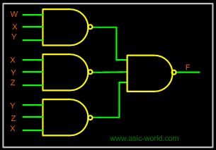

Slide 14
Analyze Yourself
11. ______ is the mathematical representation used to show the relation between the inputs and the outputs of a gate.
Boolean expression
Characteristic equation
Both
12. The logic expression AB+ can be implemented by given inputs A and B to a two input _______.
NOR
Exclusive NOR gate
Exclusive OR gate
NAND gate

Slide 15
Analyze Yourself
13. A∙(B+C)=AB+AC represents ________ law.
Commutative
Associative
Distributive
14. (A∙B) ∙C= A∙(B∙C) represents ______ law.
Commutative
Associative
Distributive

Slide 16
Analyze Yourself
15. According to DeMorgan’s theorem : NOR = ______.
Bubbled OR
Bubbled NOR
Bubbled AND
16. According to DeMorgan’s theorem : NAND = ______.
Bubbled AND
Bubbled NAND
Bubbled OR

Slide 17
Analyze Yourself
17. Standard two forms of Boolean expression are ____________.
POS and POP
POS and SOP
SOP and SOS
18. Each individual term in standard SOP form is called ________.
Literal
Maxterm
Minterm

Slide 18
Half Adder
Half adder equation needs two binary inputs and it produces two output sum and carry.
A
Half Adder
Carry = AB
B
Inputs
Output
Sum = A ex-or B
B
Input |  | Output
A | B | Carry | Sum
0 | 0 | 0 | 0
0 | 1 | 0 | 1
1 | 0 | 0 | 1
1 | 1 | 1 | 0

Slide 19
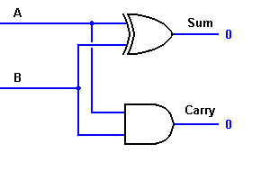
Half Adder using Logic Gates

Slide 20
Full Adder
Inputs
A
Half Adder
Carry = AB+ A Cin +B Cin
B
Output
Cin
Sum = A ex-or B ex-or Cin
Input |  |  | Output
A | B | Cin | Carry | Sum
0 | 0 | 0 | 0 | 0
0 | 0 | 1 | 0 | 1
0 | 1 | 0 | 0 | 1
0 | 1 | 1 | 1 | 0
1 | 0 | 0 | 0 | 1
1 | 0 | 1 | 1 | 0
1 | 1 | 0 | 1 | 0
1 | 1 | 1 | 1 | 1

Slide 21
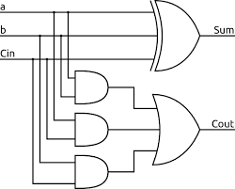
Full Adder

Slide 22
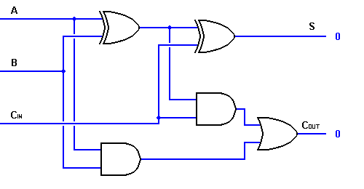
Full Adder using two Half Adder

Slide 23
Analyze Yourself
19. The output of a ________ circuit at any instant of time is dependent only on the inputs present at that instant of time.
Combinational
Sequential
Combinational and sequential
20. The output of a ________ circuit at any instant of time is dependent only on the present inputs as well as the past inputs/outputs.
Combinational
Sequential
None of these

Slide 24
Analyze Yourself
21. Sequential circuit contains ______.
No memory element
At least one memory element
All inputs applied simultaneously
22. The _______ circuits do not contain any memory element.
Combinational
Sequential
None of these

Slide 25
Analyze Yourself
23. The result of binary addition 1+1 is _______.
Carry 0, sum 0
Carry 0, sum 1
Carry 1, sum 0
Carry 1, sum1
24. The result of binary addition 1+1+1 is ______.
Carry 0, sum 0
Carry 0, sum 1
Carry 1, sum 0
Carry 1, sum1

